Slide 1
Embedded Software Engineering Project
Intersection Smart Traffic Control
Group name: Something
Members:
Ferhad
Negin
Tao Zhao
Raghuveer
Zaur

Slide 2
Content
Introduction
Requirements
Literature review
Diagrams
Implementation and simulation
Future scope
Conclusion

Slide 3
Introduction
Intersection traffic control system
Default priority: Emergency car>pedestrian>ordinary car
Traffic flow scenarios may happen
Priority based on number of cars and time-to-reach the intersection
Number of cars>time-to-reach

Slide 4
Requirements
Automatically Driven Networked Vehicles
Pedestrians equipped by a smart device to send/receive commands
Collision Avoidance
Connection between cars/pedestrians and the main control system
Parameters to formulate and illustrate the relations
Time-to-reach the intersection
Car speed
Pedestrian allowed time-to-pass
Car type flag (emergency/ordinary car)
Priority values

Slide 5
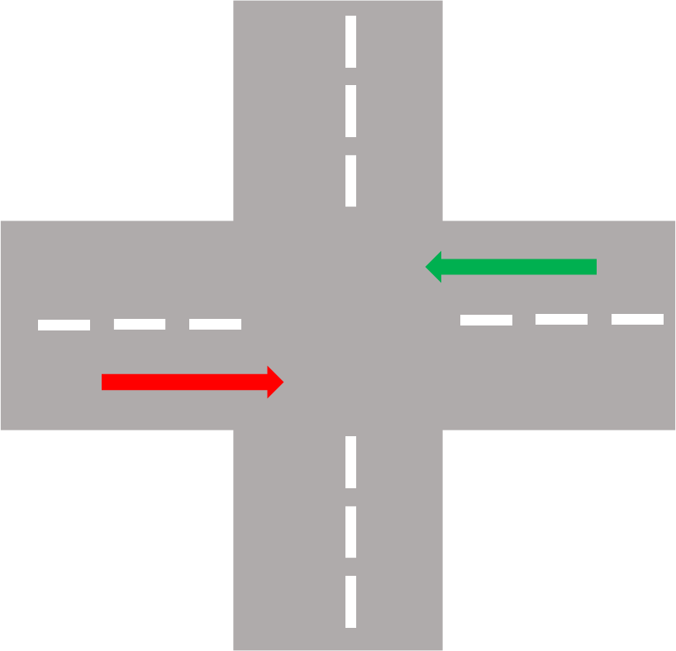

Literature review
N
Traffic flow scenario 1
W
E
S

Slide 6
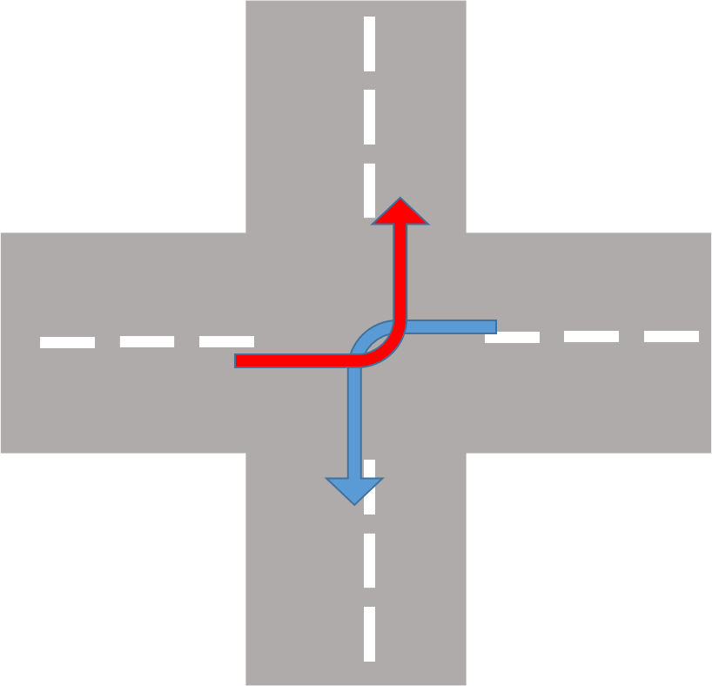

Literature review
N
Traffic flow scenario 2
W
E
S

Slide 7
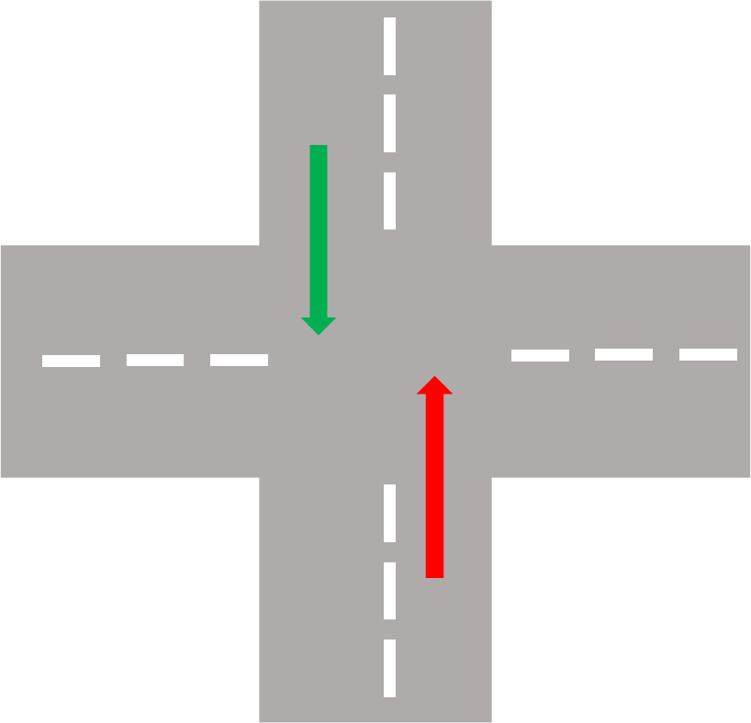

Literature review
N
Traffic flow scenario 3
W
E
S

Slide 8
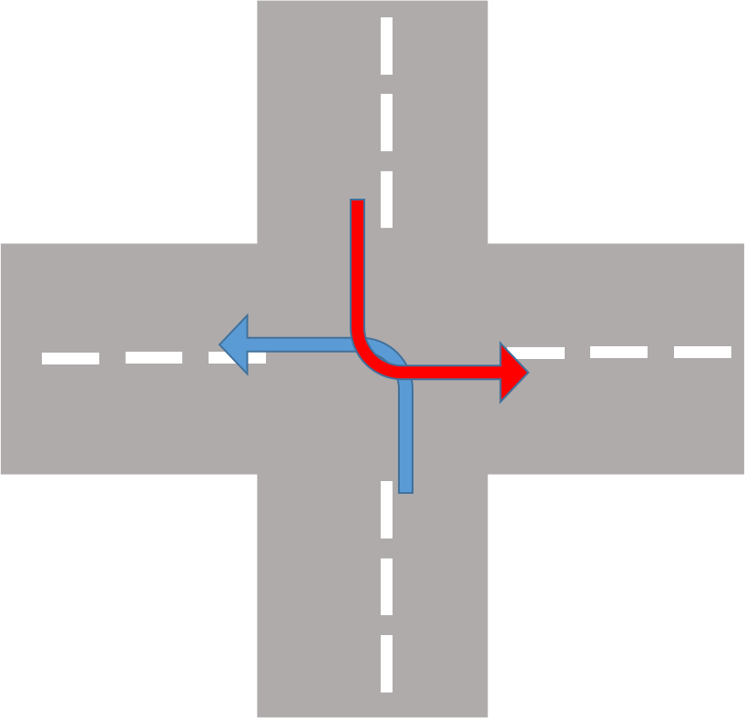
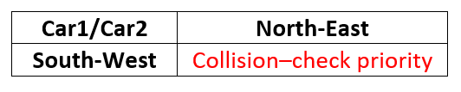
Literature review
N
Traffic flow scenario 4
W
E
S

Slide 9
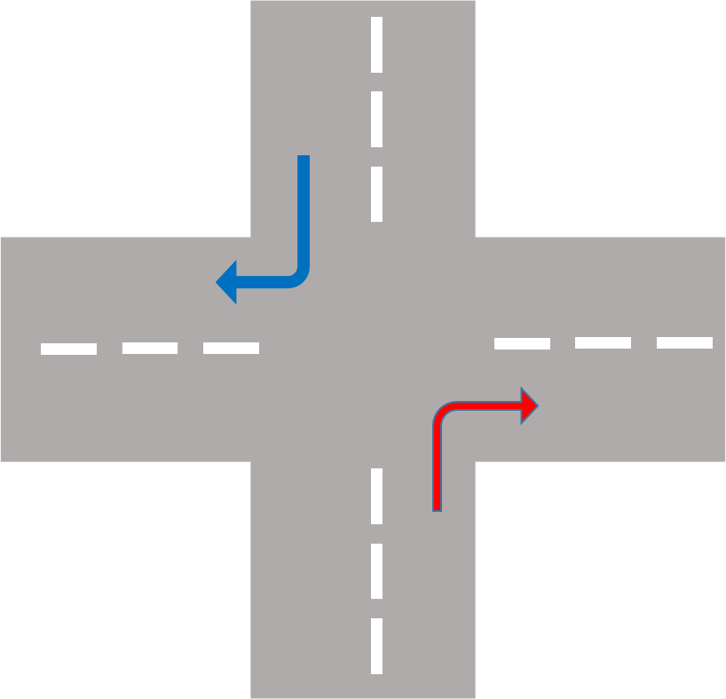
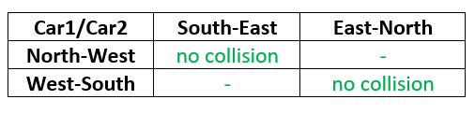
Literature review
N
Note: turning right is always possible,
simultaneously.
W
E
S

Slide 10
Literature review
Priority based on number of cars and time-to-reach
The road with the greater number of cars has highest priority in general.
The prioritizing algorithm goes through 3 main cases.

Slide 11
Literature review
Priority based on number of cars and time-to-reach
Case1: Less than 3 cars in a queue
The car with less time-to-reach has the highest priority.

Slide 12
Literature review
Priority based on number of cars and time-to-reach
Case2: 3 cars and more in a queue
The more number of cars queue has the highest priority.

Slide 13
Literature review
Priority based on number of cars and time-to-reach
Case3: Equal number od cars in queue
The line with lowest time-to-reach has the highest priority.

Slide 14
Block diagram

Slide 15
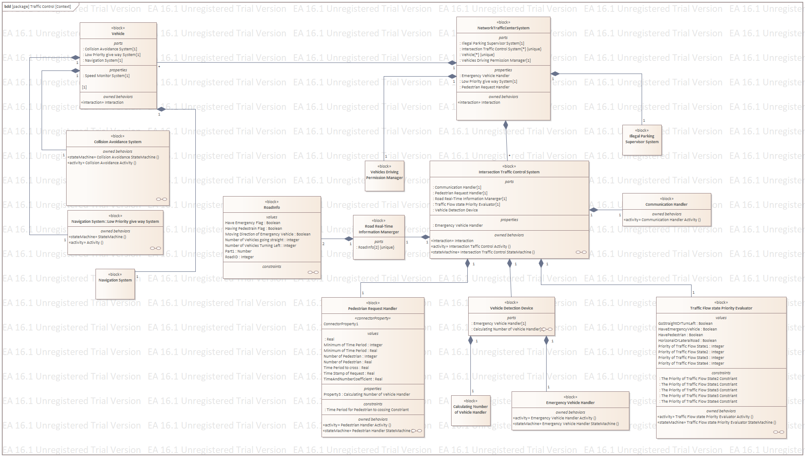

Slide 16
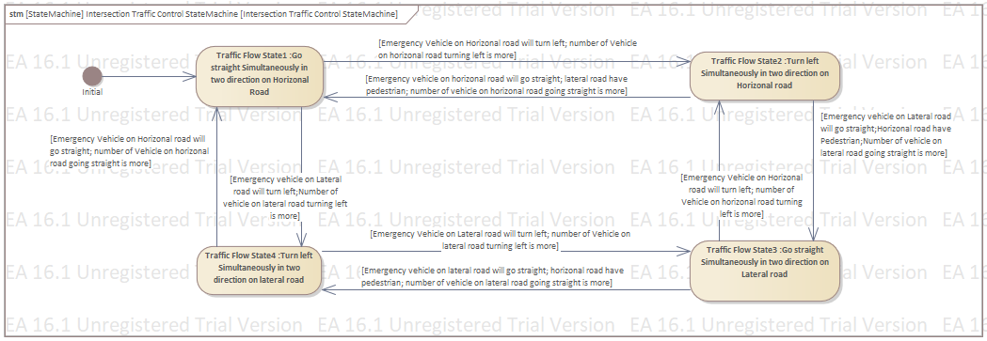
Intersection control state machine

Slide 17
Intersection control activity diagram

Slide 18
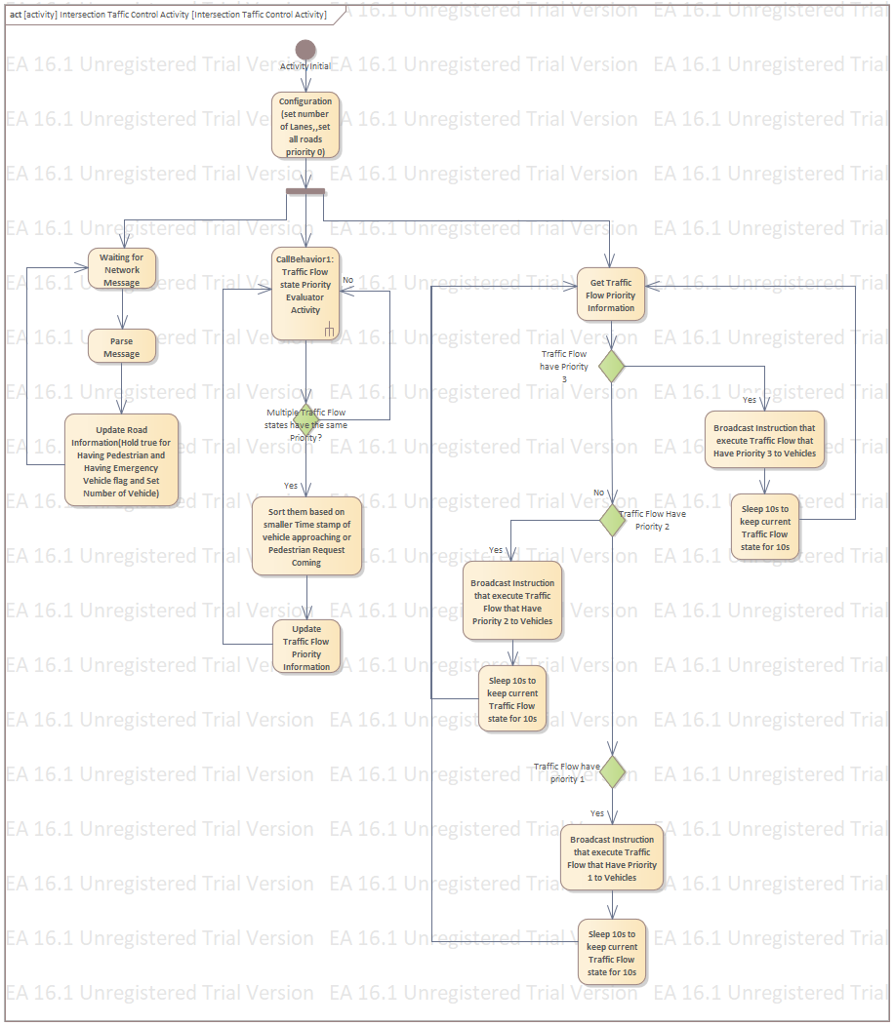

Slide 19
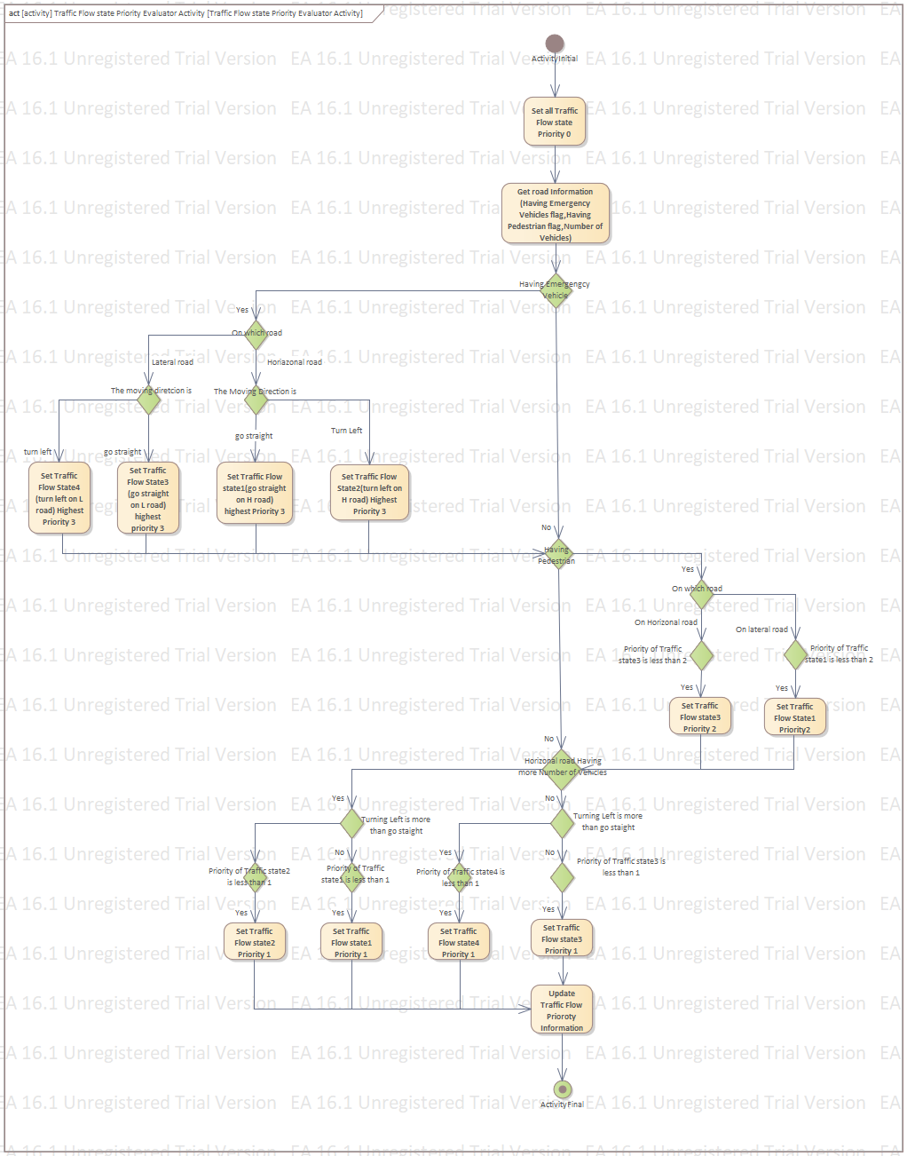

Slide 20
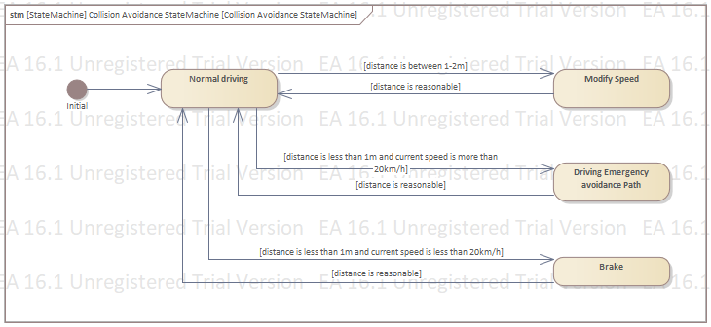
Collision avoidance state machine

Slide 21
Collision avoidance activity diagram

Slide 22
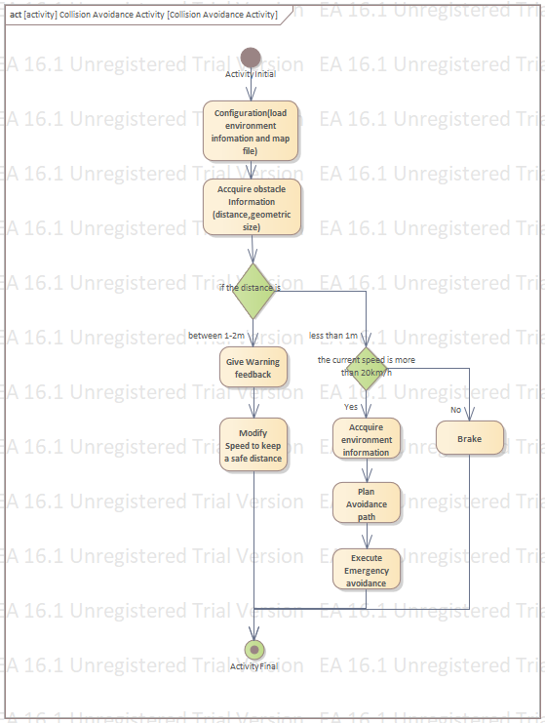

Slide 23
Sequence diagram

Slide 24
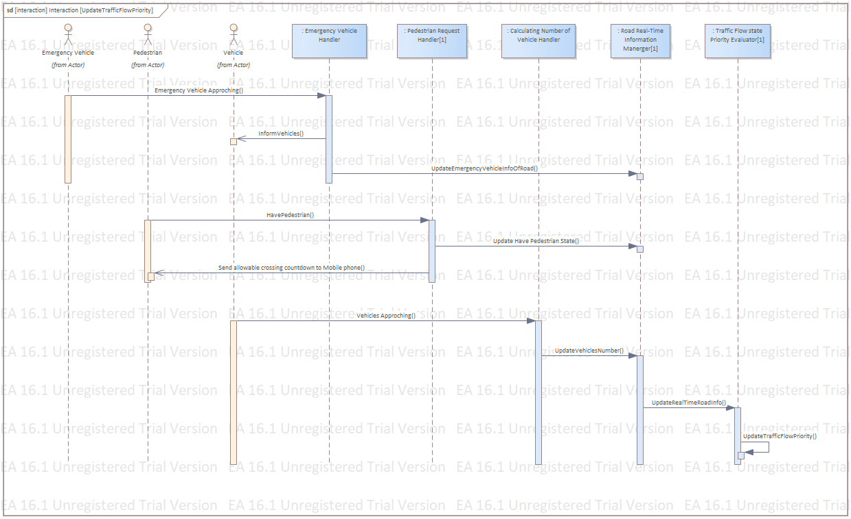

Slide 25
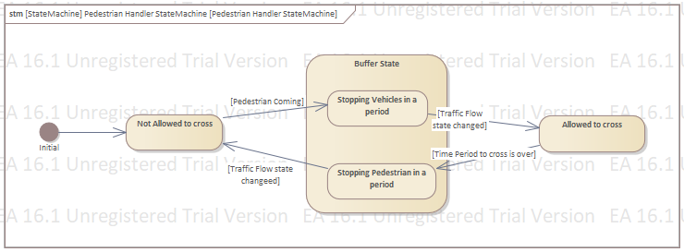
Pedestrian state machine

Slide 26
Pedestrian activity diagram

Slide 27
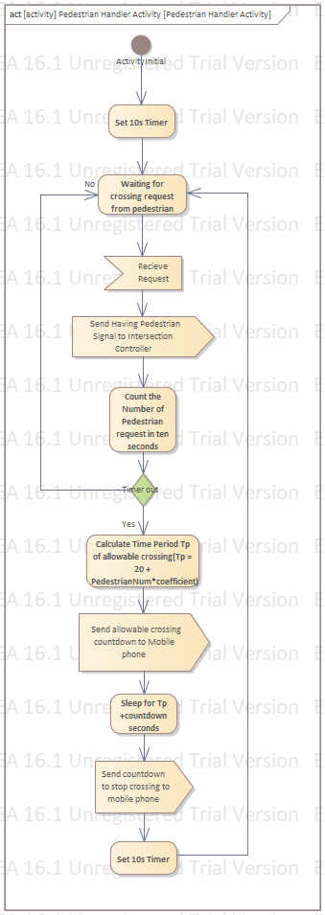

Slide 28
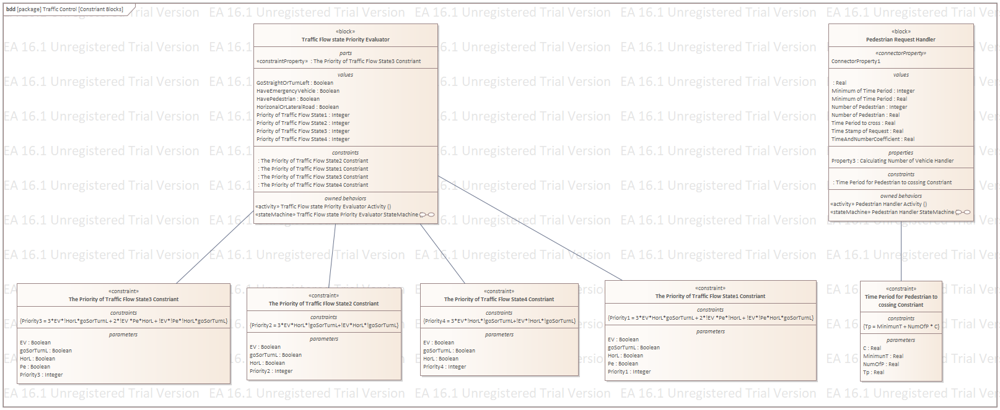
Constraints list

Slide 29
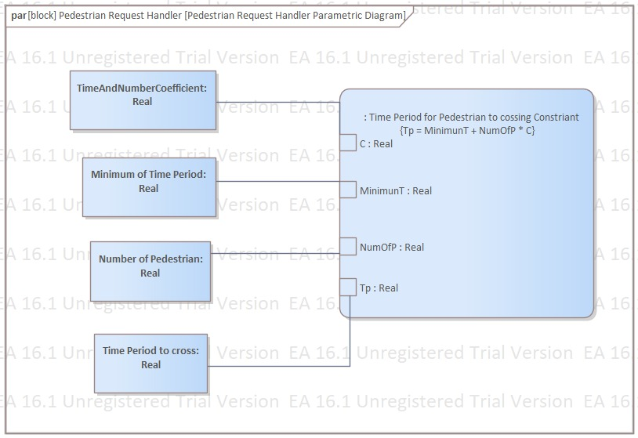
Pedestrian request parametric diagram

Slide 30
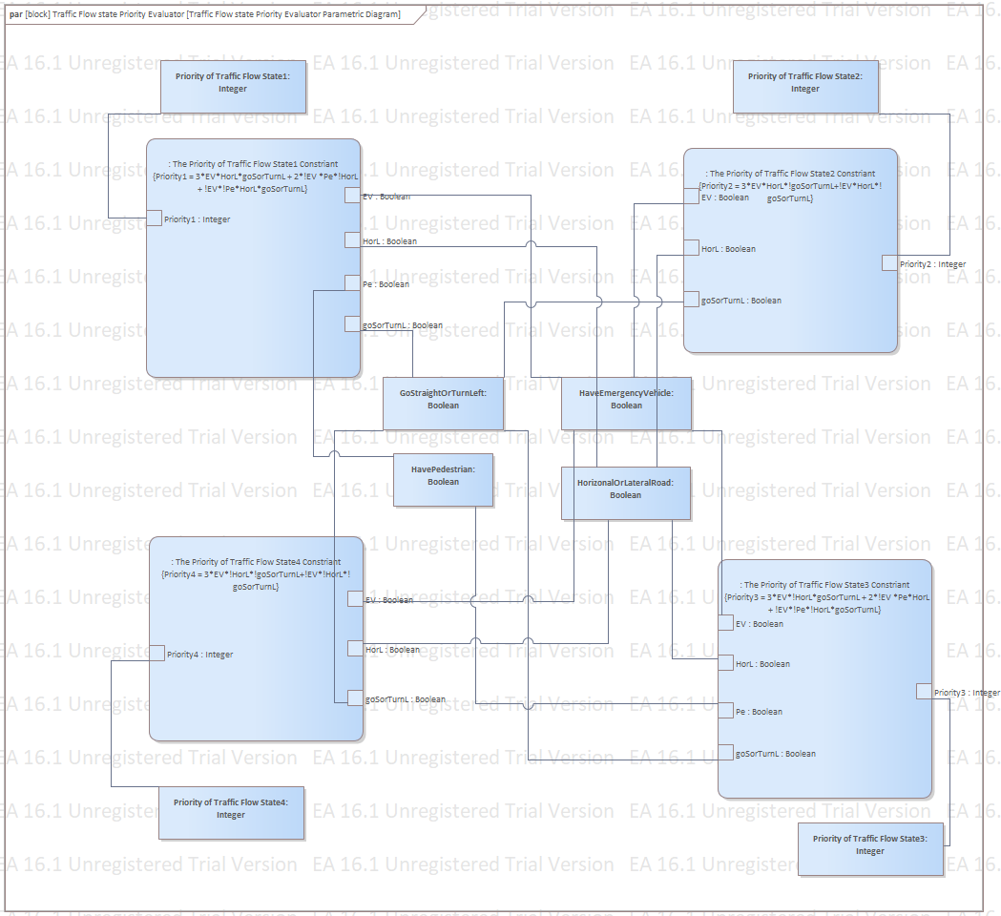
Parametric diagram

Slide 31
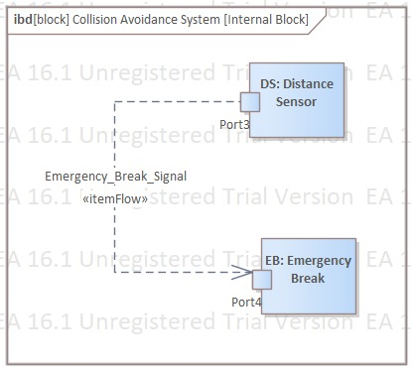
Internal block diagram

Slide 32
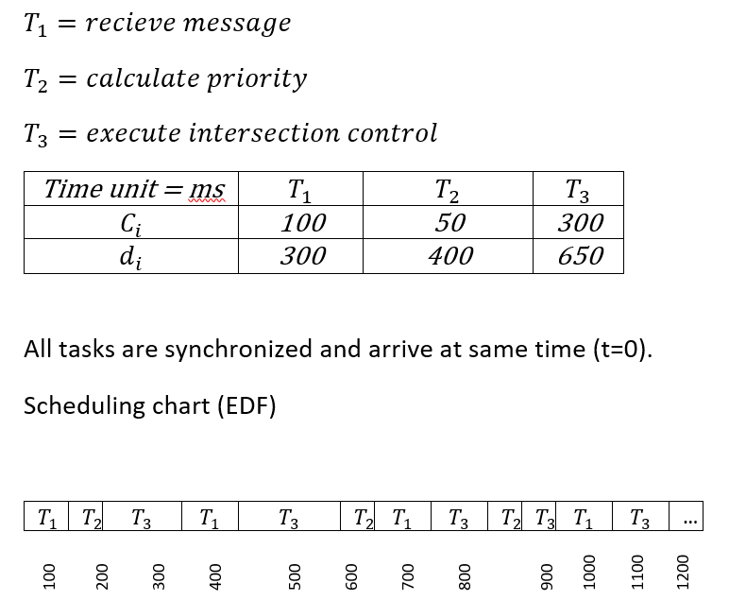
Scheduling

Slide 33
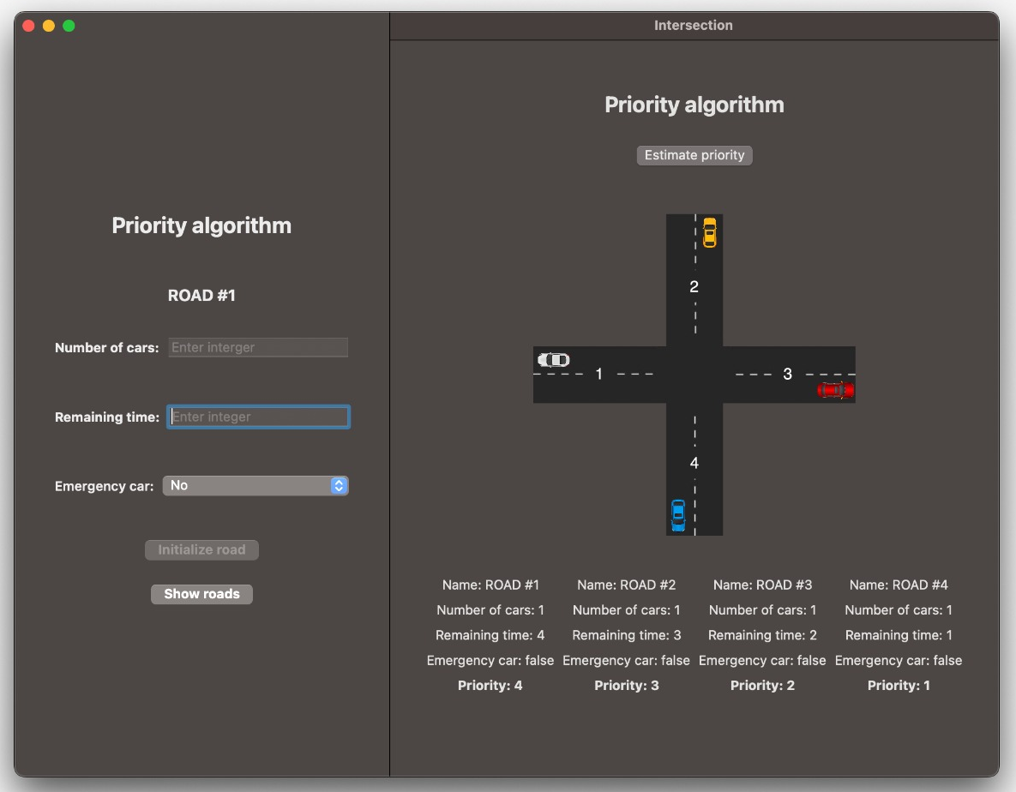
Implementation and simulation - GUI

Slide 34
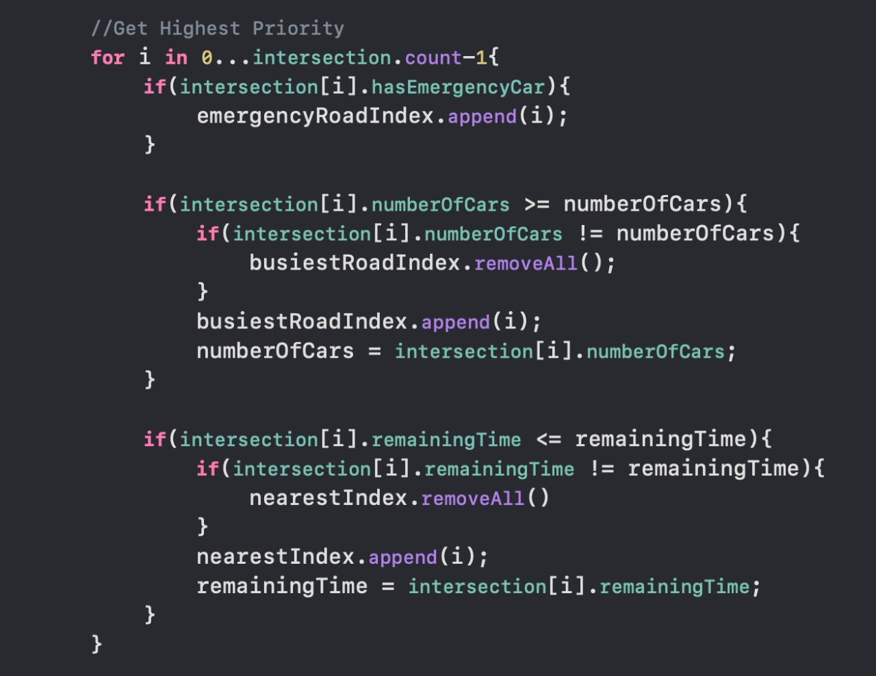
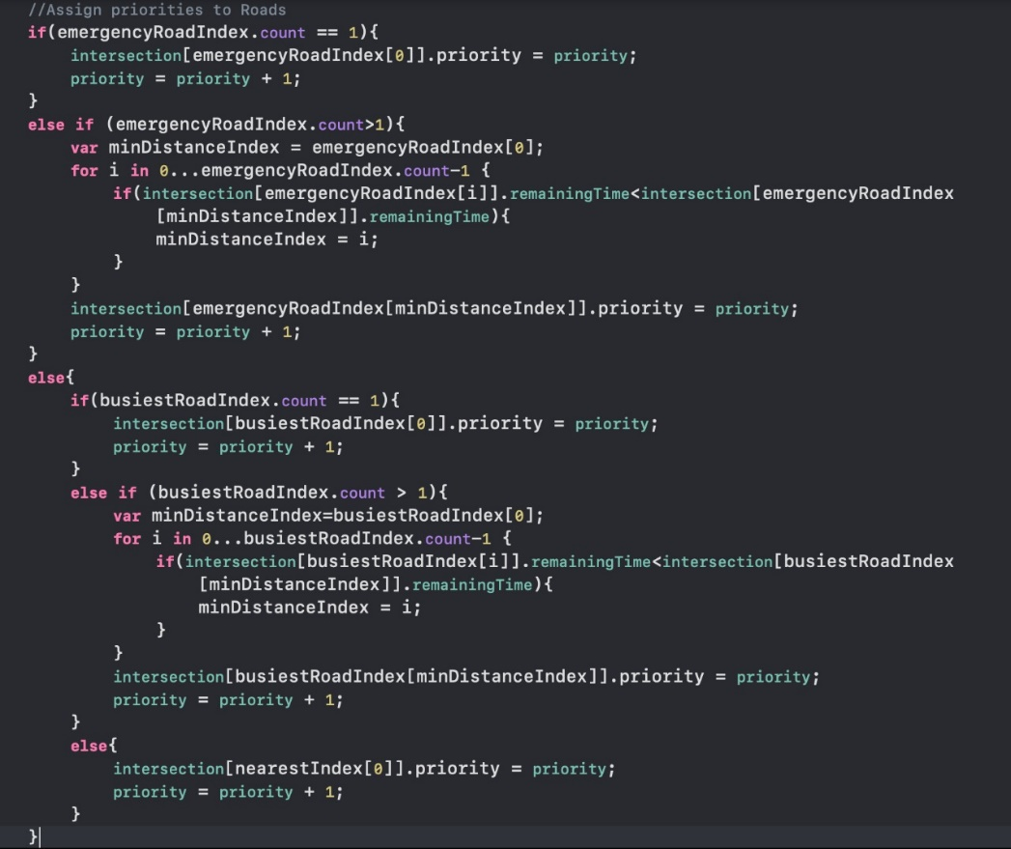
Implementation and simulation - GUI

Slide 35
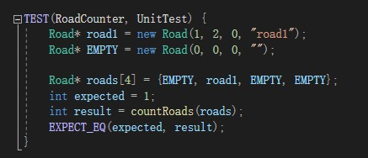
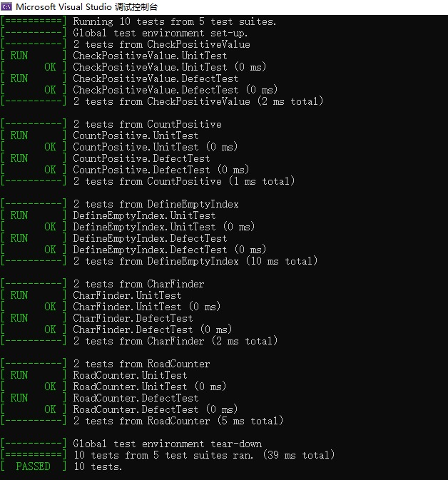
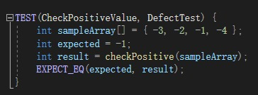
Literature review
Testing

Slide 36
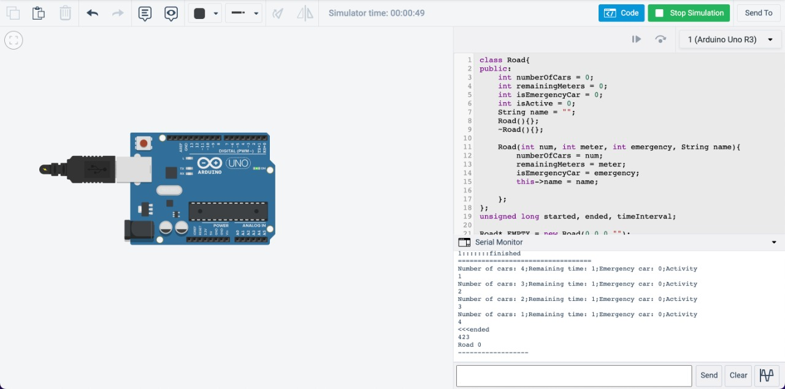
Implementation and Simulation - Arduino

Slide 37
Future scope
Traffic flow prediction algorithms
Cross intersection communication
Taking into account of vehicle parameters from maps
Time to destination
Optimized estimated path
Control strategy based on V2V communication
More complex commands from main system controller like speed up/speed down
Considering accidents

Slide 38
Conclusion
Designed intersection traffic control system based on the main logic
Investigating possible scenarios
Prioritization
Utilizing SysML, UML diagrams for better understanding

